Slide 1

Capstone Project – The Battle of Neighborhoods
Chetan R Kumbar

Slide 2
Contents
Introduction.
Data Acquisition and Cleaning.
Methodology.
Results.
Discussion.
Conclusion.

Slide 3
Introduction
Background: Safety is a top concern when moving to a new area. If you don’t feel safe in your own home. You are not going to enjoy living there.
Problem: This project aims to select the safest borough in London based on the total crimes, explore the neighborhoods of that borough to find the 10 most common venues in each neighborhoods and finally cluster the neighborhoods using K-means clustering.
Interest: Expats who are considering to relocate to London will be interested to identify the safest borough in London and explore its neighborhoods and common places around the neigbhboroods.

Slide 4
Data Acquisition and Cleaning
Data Acquisition: The data acquired for this project is a combination of data from three sources:
1. The first data source of the project uses a London crime data that shows the crime per borough in London.
2. The second source of data from the Wikipedia page that contains of list of London borough.
3. The third data source is the list of Neighbourhoods in the Royal Borough of Kingston upon Thames as found on Wikipedia page.

Slide 5
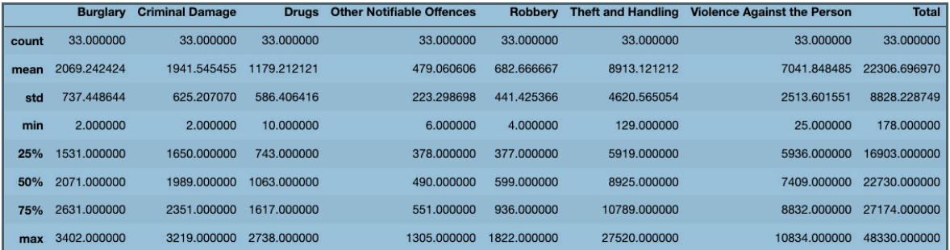
Methodology
Exploratory Data Analysis
Statistical summary of crimes
The count for each of the major categories of crime returns the value the value 33 which is the number of London boroughs.

Slide 6
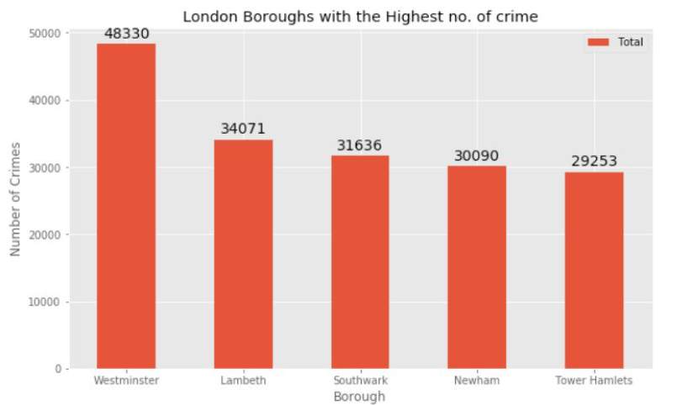
Borough with the highest crime rates

Slide 7
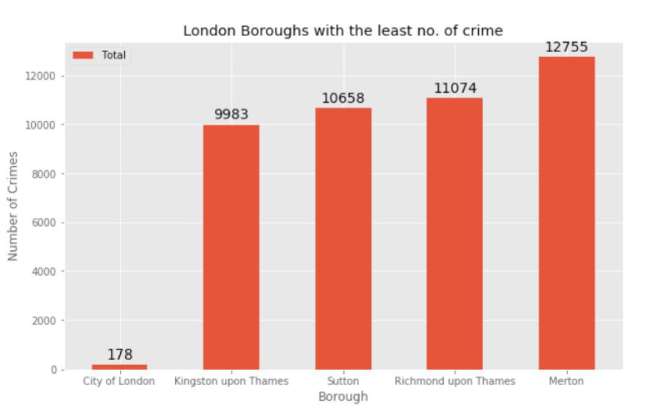
Borough with the lowest crime rates

Slide 8
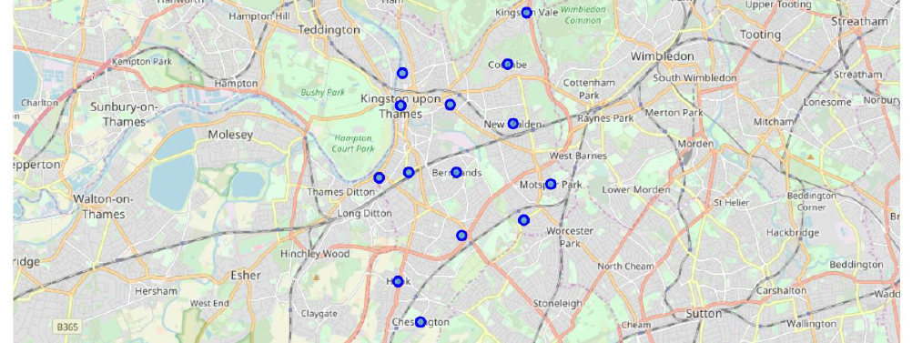
Neighborhoods in Kingston upon Thames
There are 15 neighborhoods in the royal borough of Kingston upon Thames, they are visualised on a map using folium on python.

Slide 9
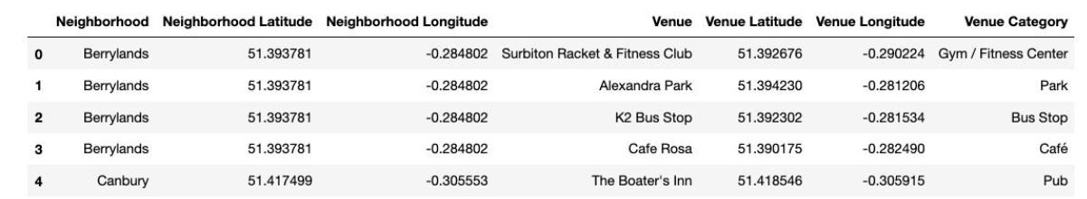
Methodology(cont...)
Modelling:
Using the final dataset containing the neighborhoods in Kingston upon Thames along with the latitude and longitude, we can find all the venues within a 500 meter radius of each neighborhood by connecting to the Foursquare API.
One hot encoding is done on the venues data. The Venues data is then grouped by the Neighborhood and the mean of the venues are calculated, finally the 10 common venues are calculated foreach of the neighbourhoods.

Slide 10
Methodology(cont...)
To help people find similar neighborhoods in the safest borough we will be clustering similar neighborhoods using K - means clustering which is a form of unsupervised machine learning algorithm that clusters data based on predefined cluster size.
We will use a cluster size of 5 for this project that will cluster the 15 neighborhoods into 5 clusters. The reason to conduct a K- means clustering is to cluster neighborhoods with similar venues together so that people can shortlist the area of their interests based on the venues/amenities around each neighbourhood.

Slide 11
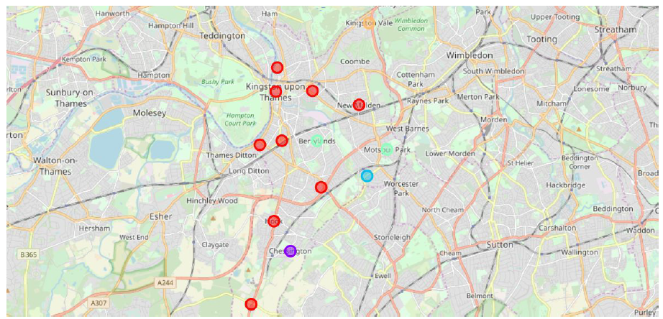
Results
After running the K-means clustering we can access each cluster created to see which neighborhoods were assigned to each of the five clusters. Visualizing the clustered neighborhoods on the map using the Folium library.

Slide 12
Results
Each cluster is color coded for the ease of presentation, we can see that majority of the neighborhood falls in the red cluster which is the first cluster. Three neighborhoods have their own cluster (Blue, Purple and Yellow), these are clusters two three and five. The green cluster consists of two neighborhoods which is the 4th cluster.
The cluster one is the biggest cluster with 9 of the 15 neighborhoods in the borough Kingston upon Thames. Upon closely examining these neighborhoods we can see that the most common venues in these neighborhoods are Restaurants, Pubs, Cafe, Supermarkets and stores.
Looking into the neighborhoods in the second, third and fifth clusters, we can see these clusters have only one neighborhood in each. This is because of the unique venues in each of the neighborhoods, hence they couldn't be clustered into similar neighborhoods.
The fourth cluster has two neighborhoods in it, these neighborhoods have common venues such as Parks, Gym/Fitness centers, Bus Stops, Restaurants, Electronics Stores and Soccer fields etc.

Slide 13
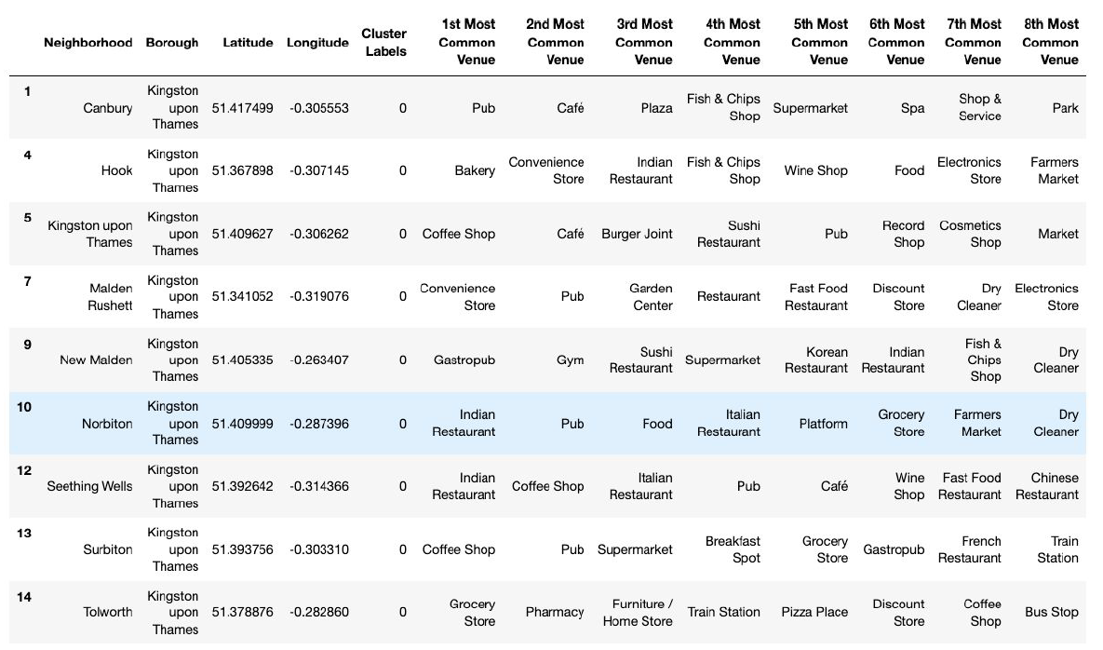

Slide 14
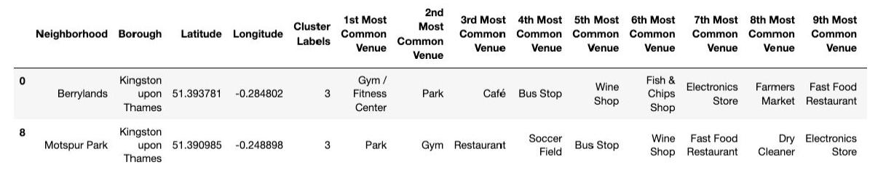
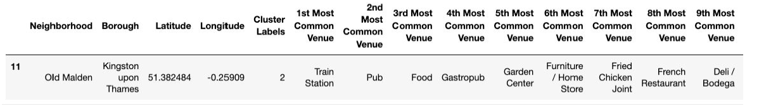
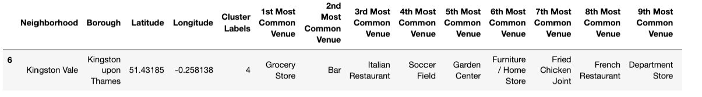

Slide 15
Discussion
The aim of this project is to help people who want to relocate to the safest borough in London, expats can chose the neighborhoods to which they want to relocate based on the most common venues in it.
For example if a person is looking for a neighborhood with good connectivity and public transportation we can see that Clusters 3 and 4 have Train stations and Bus stops as the most common venues.
If a person is looking for a neighborhood with stores and restaurants in a close proximity then the neighborhoods in the first cluster is suitable.
For a family I feel that the neighborhoods in Cluster 4 are more suitable dues to the common venues in that cluster, these neighborhoods have common venues such as Parks, Gym/Fitness centers, Bus Stops, Restaurants, Electronics Stores and Soccer fields which is ideal for a family.
The choices of neighborhoods may vary from person to person.

Slide 16
Conclusion
This project helps a person get a better understanding of the neighborhoods with respect to the most common venues in that neighborhood. It is always helpful to make use of technology to stay one step ahead i.e. finding out more about places before moving into a neighborhood.
We have just taken safety as a primary concern to shortlist the safest borough of London. The future of this project includes taking other factors such as cost of living in the areas into consideration to shortlist the borough, such as filtering areas based on a predefined budget.

Slide 17
Thank you
- Chetan Kumbar

